Slide 1
Eigenfaces for recognition
Mathew Turk and Alex Pentland

Slide 2
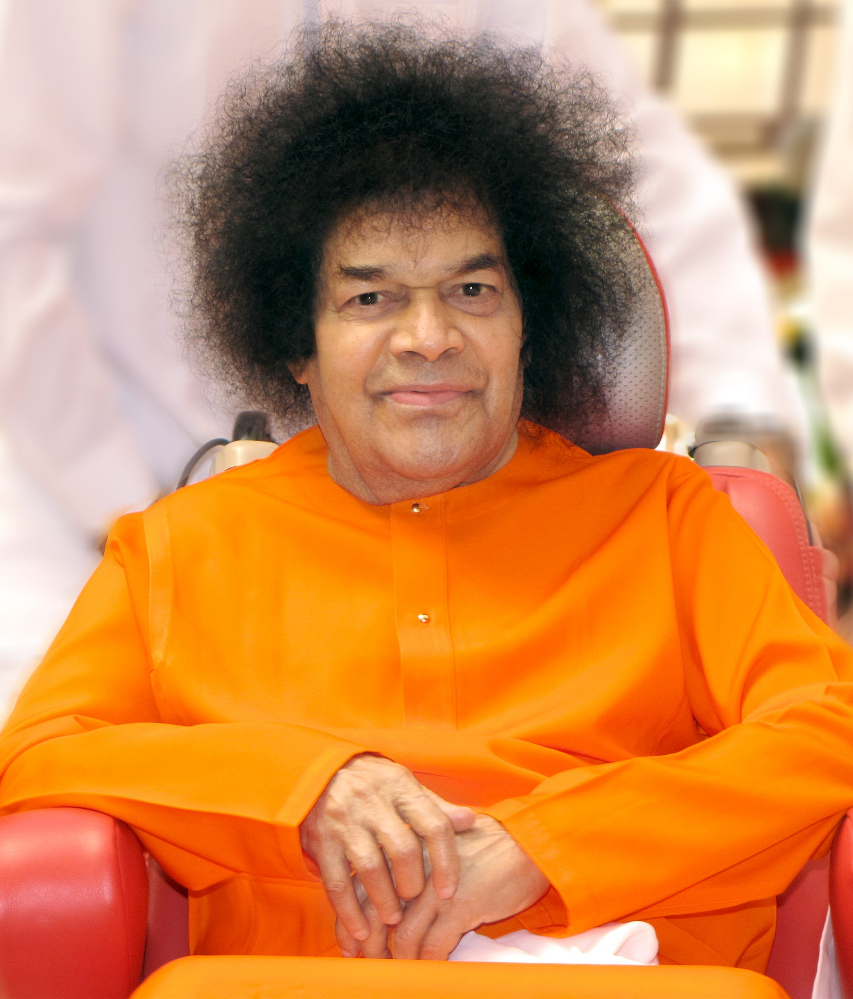
Humble Pranams At his lotus feet

Slide 3
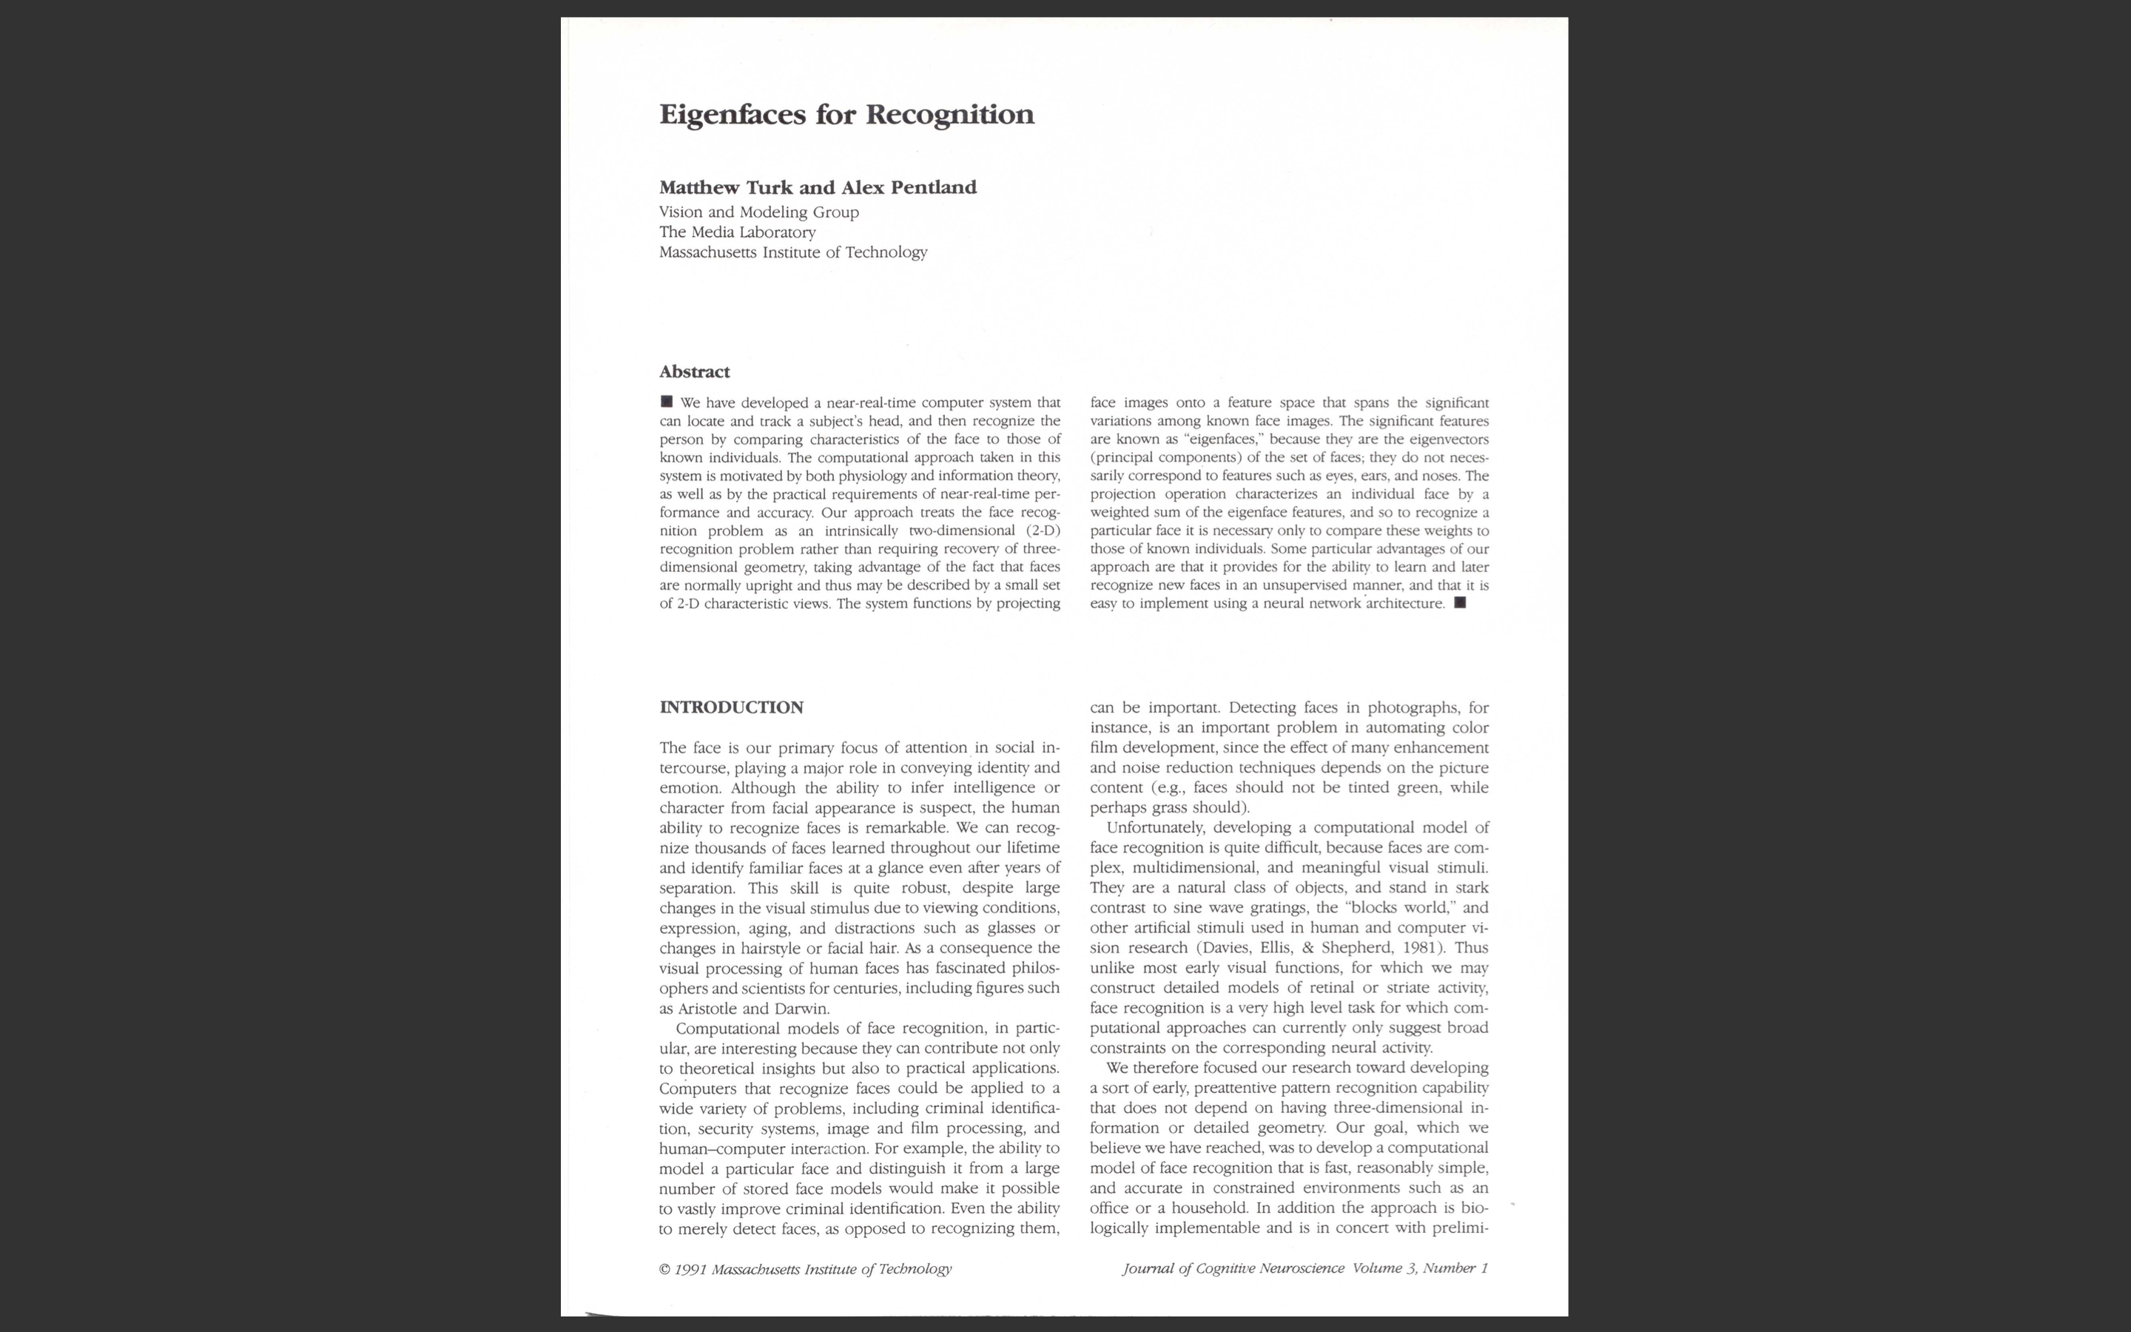

Slide 4

PCA
What is PCA?
What does PCA do?
How is PCA done?

Slide 5
PCA
PCA stands for Principal Component Analysis.
Principal Component Analysis, is a dimensionality-reduction method that is often used to reduce the dimensionality of large data sets, by transforming a large set of variables into a smaller one that still contains most of the information in the large set.
The idea of PCA is simple — reduce the number of variables of a data set, while preserving as much information as possible.

Slide 6
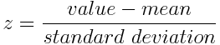
STEP 1: STANDARDIZATION
Mathematically, this can be done by subtracting the mean and dividing by the standard deviation for each value of each variable.
Once the standardization is done, all the variables will be transformed to the same scale.

Slide 7
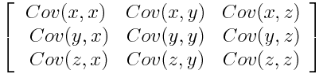
STEP 2: COVARIANCE MATRIX COMPUTATION
Since the covariance of a variable with itself is its variance (Cov(a,a)=Var(a)), in the main diagonal (Top left to bottom right) we actually have the variances of each initial variable. And since the covariance is commutative (Cov(a,b)=Cov(b,a)), the entries of the covariance matrix are symmetric with respect to the main diagonal, which means that the upper and the lower triangular portions are equal.
The covariance matrix is a p × p symmetric matrix (where p is the number of dimensions) that has as entries the covariances associated with all possible pairs of the initial variables. For example, for a 3-dimensional data set with 3 variables x, y, and z, the covariance matrix is a 3×3 matrix of this from:

Slide 8
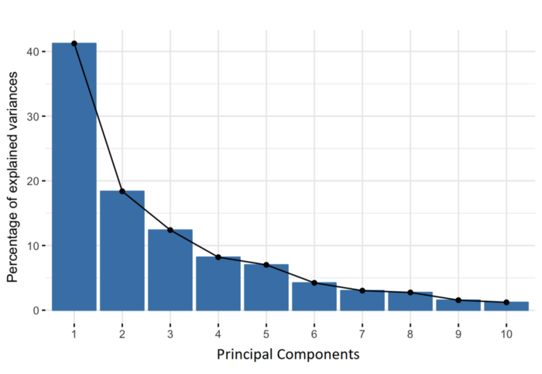
STEP 3: COMPUTE THE EIGENVECTORS AND EIGENVALUES OF THE COVARIANCE MATRIX TO IDENTIFY THE PRINCIPAL COMPONENTS
Geometrically speaking, principal components represent the directions of the data that explain a maximal amount of variance, that is to say, the lines that capture most information of the data. The relationship between variance and information here, is that, the larger the variance carried by a line, the larger the dispersion of the data points along it, and the larger the dispersion along a line, the more the information it has.

Slide 9
How is PCA done?
As there are as many principal components as there are variables in the data, principal components are constructed in such a manner that the first principal component accounts for the largest possible variance in the data set.

Slide 10
Eigenvectors and Eigenvalues
The eigenvectors of the Covariance matrix are actually the directions of the axes where there is the most variance(most information) and that we call Principal Components. And eigenvalues are simply the coefficients attached to eigenvectors, which give the amount of variance carried in each Principal Component.

Slide 11
STEP 4: FEATURE VECTOR
In this step, what we do is, to choose whether to keep all these components or discard those of lesser significance (of low eigenvalues), and form with the remaining ones a matrix of vectors that we call Feature vector.
The feature vector is simply a matrix that has as columns the eigenvectors of the components that we decide to keep. This makes it the first step towards dimensionality reduction, because if we choose to keep only p eigenvectors (components) out of n, the final data set will have only p dimensions.

Slide 12
With images
255
200
100
8- bit colour
2⁸=256
255=black
0=white
240
198
156
3 X 3 Pixels
N X N
134
160
0
255
240
134
200
198
160
100
156
0

Slide 13
a₁
a₂
a₃
a₄
a_{T}
Number of rows = N X N=N²
Number of Columns= T
A =
…
So dim A= N² X T
T-Images
μ is calculated by summing all the
A_{i}’s along the columns component wise and dividing by T

Slide 14
We subtract µ from A to get M… This aids us in the calculations of the covariance matrix
μ =
So dim μ = N² X 1

Slide 15
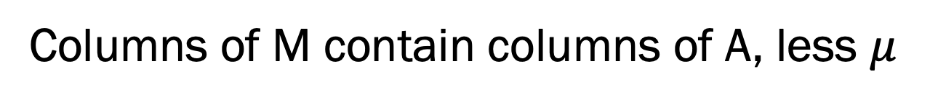

So, $$M=A−μ$$
Columns of M contain columns of A, less $μ$

Slide 16
We now define the Covariance matrix as
C₁₁ C₁₂ C₁₃ C₁₄ … C_{1N}²
C₂₁ C₂₂ C₂₃ C₂₄ … C_{2N}²
C₃₁ C₃₂ C₃₃ C₃₄ … C_{3N}²
C =
C_{N}²₁ C_{N}²₂ C_{N}²₃ C_{N}²₄ … C_{N}²_{N}²
N² X N²

Slide 17
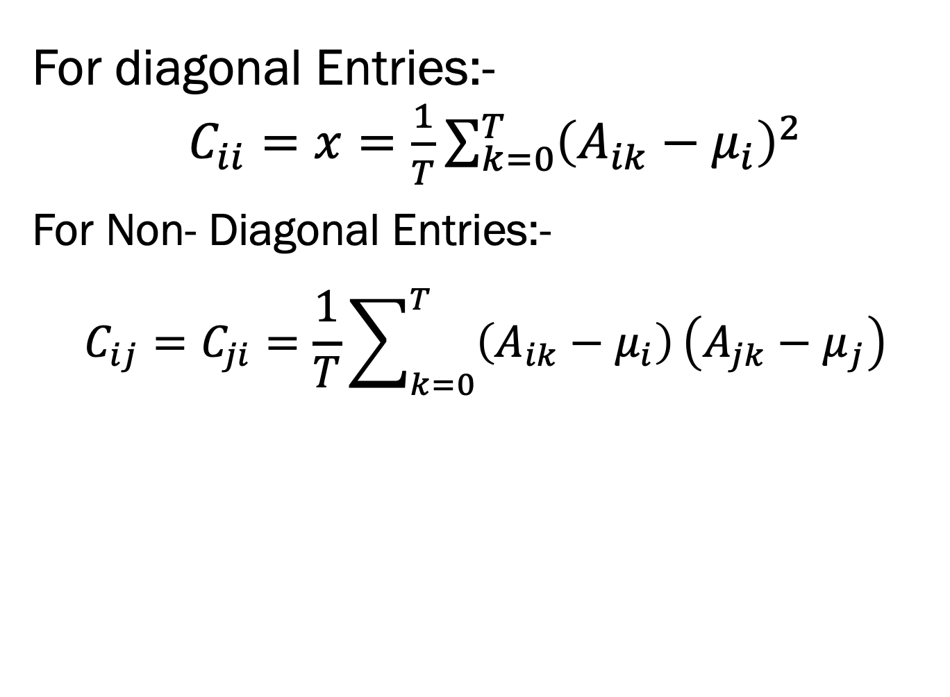
Covariance calculations
For diagonal Entries:-
$C_{ii}=x=\frac{1}{T}\sum_{k=0}^{T}{{\left(A_{ik}−μ_{i}\right)}^{2}}$
_{For Non- Diagonal Entries:-}
$$C_{ij}=C_{ji}=\frac{1}{T}\sum_{k=0}^{T}{\left(A_{ik}−μ_{i}\right)}\left(A_{jk}−μ_{j}\right)$$

Slide 18
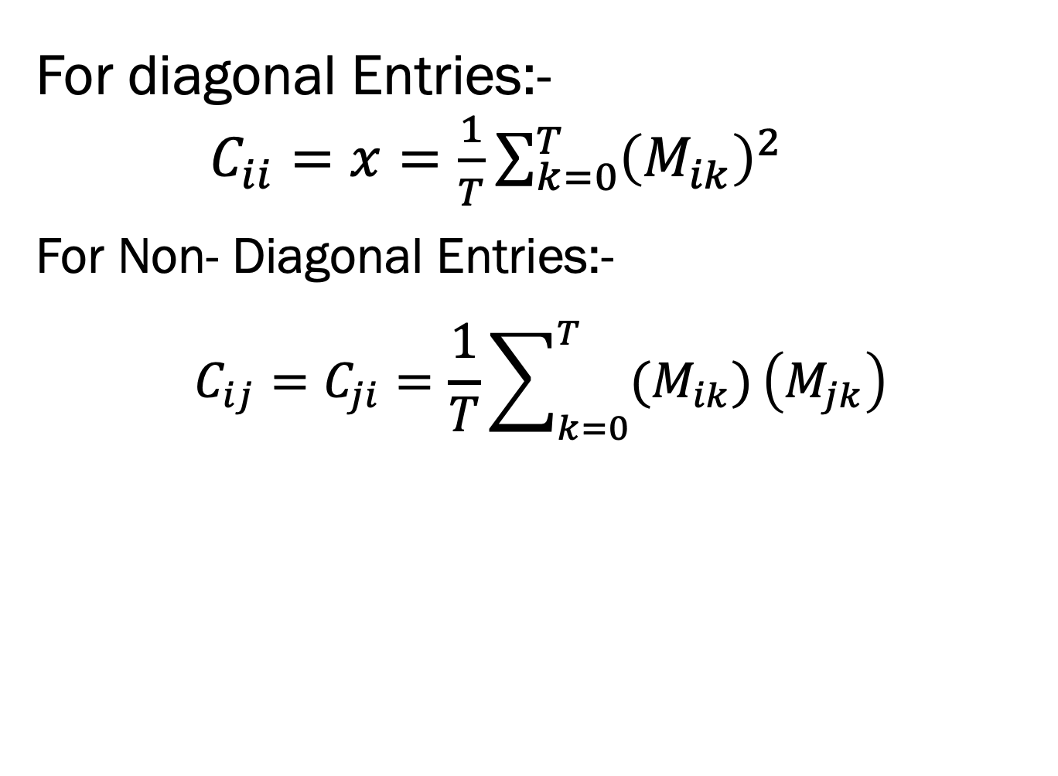
Covariance calculations
For diagonal Entries:-
$C_{ii}=x=\frac{1}{T}\sum_{k=0}^{T}{{\left(M_{ik}\right)}^{2}}$
_{For Non- Diagonal Entries:-}
$$C_{ij}=C_{ji}=\frac{1}{T}\sum_{k=0}^{T}{(M_{ik})}\left(M_{jk}\right)$$

Slide 19
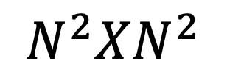
C=MM^{T}
$$N^{2}XN^{2}$$

Slide 20
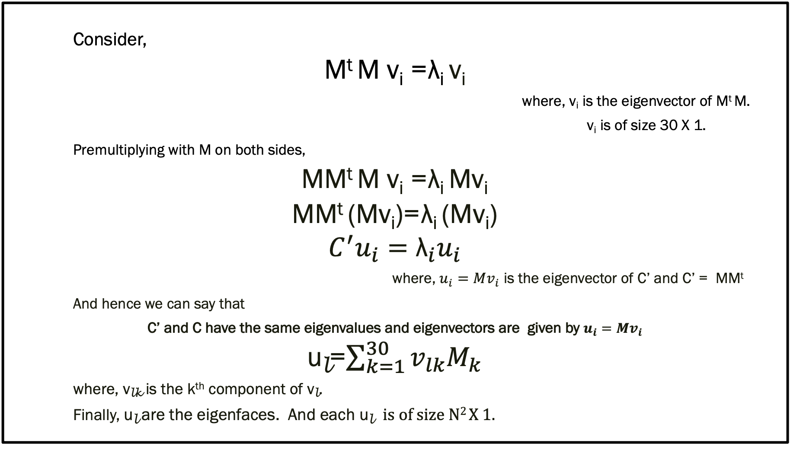
Consider,
M^{t} M v_{i} = λ_{i} v_{i}
where, v_{i} is the eigenvector of M^{t} M.
v_{i} is of size 30 X 1.
Premultiplying with M on both sides,
MM^{t} M v_{i} = λ_{i} Mv_{i}
MM^{t} (Mv_{i})= λ_{i} (Mv_{i})
$$C^{′}u_{i}={\text{λ}}_{i}u_{i}$$
where, $u_{i}=Mv_{i}$ is the eigenvector of C’ and C’ = MM^{t}
And hence we can say that
C’ and C have the same eigenvalues and eigenvectors are given by $u_{i}=Mv_{i}$
u_{l}=$\sum_{k=1}^{30}{v_{lk}M_{k}}$
where, v_{lk} is the k^{th} component of v_{l}.
Finally, u_{l} are the eigenfaces. And each u_{l} is of size N² X 1.

Slide 21
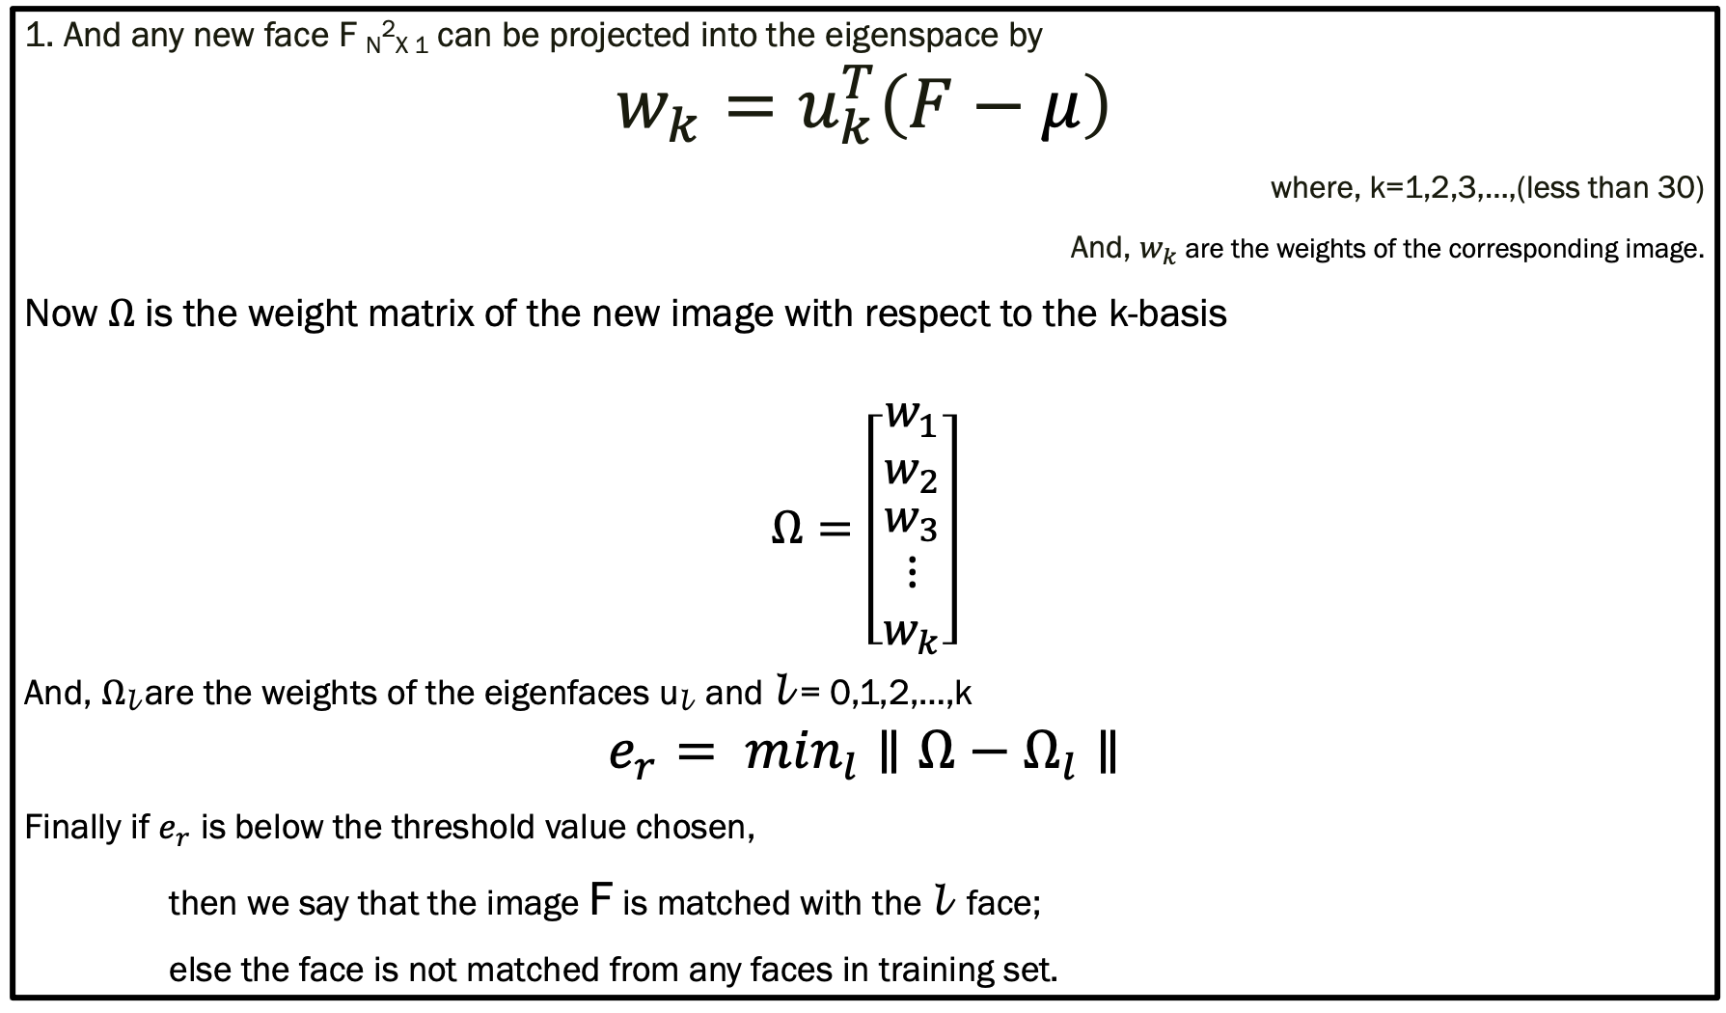
1. And any new face F _{N}²_{X 1} can be projected into the eigenspace by
$$w_{k}=u_{k}^{T}\left(F−μ\right)$$
where, k=1,2,3,…,(less than 30)
And, $w_{k}$ are the weights of the corresponding image.
Now $Ω$ is the weight matrix of the new image with respect to the k-basis
$$Ω=\left[\begin{matrix}w_{1} \\ w_{2} \\ \begin{matrix}w_{3} \\ ⋮ \\ w_{k}\end{matrix}\end{matrix}\right]$$
And, $Ω$_{l} are the weights of the eigenfaces u_{l} and l = 0,1,2,…,k
$$e_{r}= \min_{l}∥Ω−Ω_{l}∥$$
Finally if $e_{r}$ is below the threshold value chosen,
then we say that the image F is matched with the l face;
else the face is not matched from any faces in training set.

Slide 22
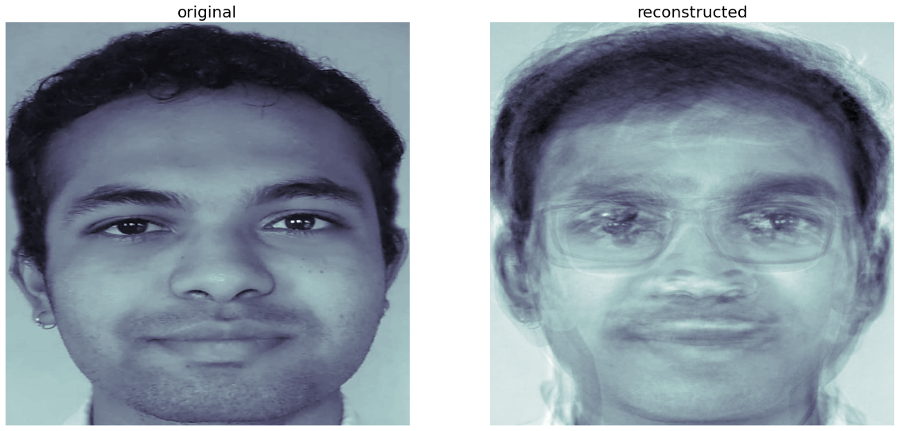
This is the image reconstructed in the 15-space

Slide 23
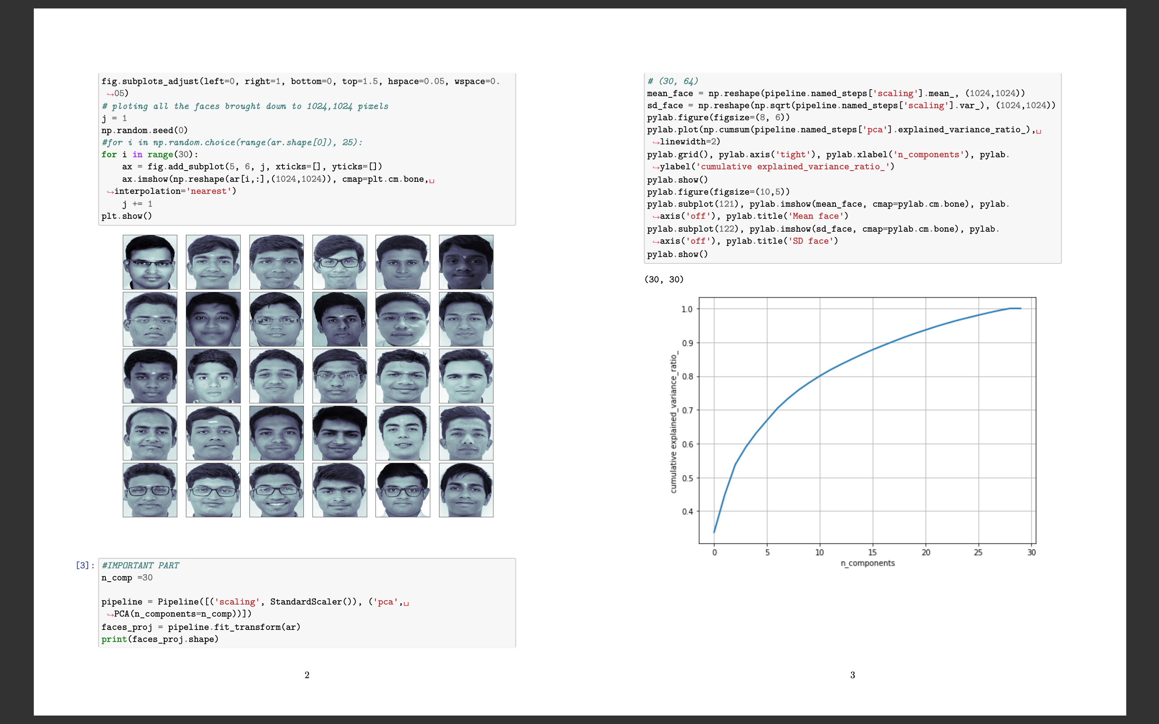
The code

Slide 24
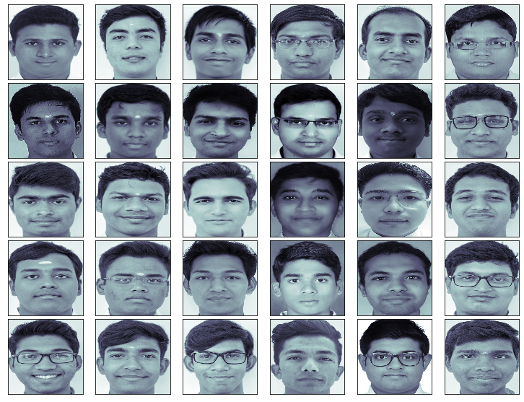

Slide 25
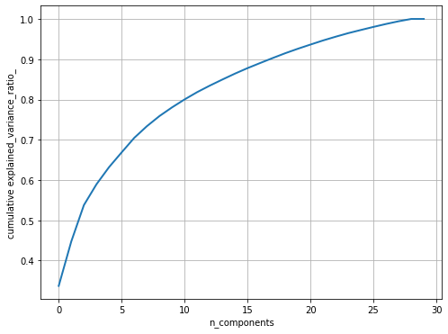
Graph:
This curve quantifies how much of the total, 64-dimensional variance is contained within the first N=30 components. For example, we see that with the digits the first 10 components contain approximately 80% of the variance, while you need around 28 components to describe close to 100% of the variance.
Here we see that our two-dimensional projection loses a lot of information (as measured by the explained variance) and that we'd need about 17 components to retain around 90% of the variance. Looking at this plot for a high-dimensional dataset can help you understand the level of redundancy present in multiple observations.

Slide 26
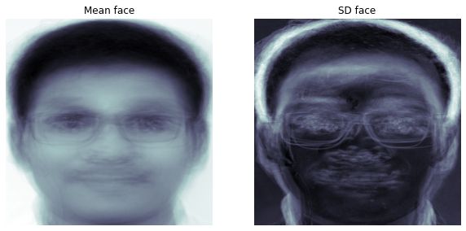
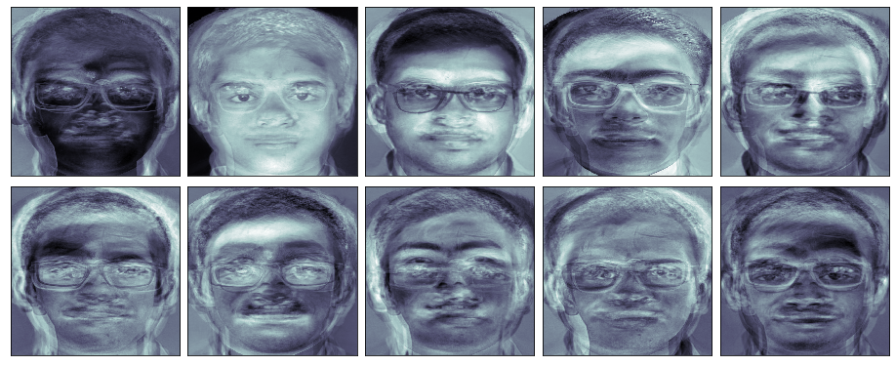
Mean, sd & Eigenfaces

Slide 27
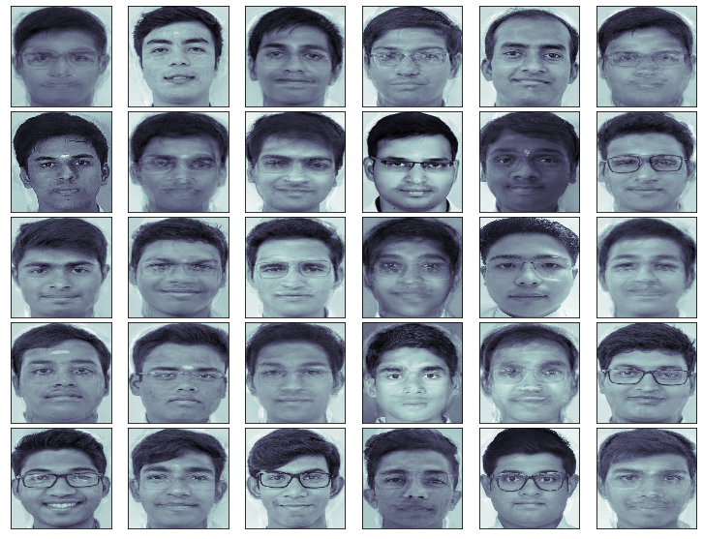
Reconstructed faces with 15 components

Slide 28
Advantages:
Easy to implement and computationally less expensive.
No knowledge (such as facial feature) of the image required (except id).
Limitations :
Proper centered face is required for training/testing.
The algorithm is sensitive to lightining, shadows and also scale of face in the image .
Front view of the face is required for this algorithm to work properly.

Slide 29
Bibliography
Slavković, Marijeta & Jevtić, Dubravka. (2012). Face Recognition Using Eigenface Approach*. Serbian Journal of electrical engineering. 9. 121-130. 10.2298/SJEE1201121S.
https://www.geeksforgeeks.org/ml-face-recognition-using-eigenfaces-pca-algorithm/
https://towardsdatascience.com/a-complete-guide-to-principal-component-analysis-pca-in-machine-learning-664f34fc3e5a
https://medium.datadriveninvestor.com/principal-components-analysis-pca-71cc9d43d9fb

Slide 30

Jai Sai ram

